Slide 1
Genesee County:
Material Recovery Facility Feasibility Study
Michigan State University UP 494: Planning Practicum April 29th, 2016
Vincent Chen
Hank Hong
Zhangjingyan Liu
Greg Porretto
Vickie Zuo
Notes:
Acknowledgments
We would like to thank Genesee County Metropolitan Planning Commission (GCMPC) and MSU for their collaboration to give our team the opportunity to not only be a part of, but also lead this investigation that was a direct priority of the Genesee County Solid Waste Management Plan. Other contributions have been made by additional sources from ReCommunity and The Resource Recovery and Recycling Authority of Southwest Oakland County (RRRASOC). Having assistance and guidance has made our research and work more successful and ultimately has given every team member a sense of reality in the professional field of planning.

Slide 2
Introduction
The purpose of this research is to determine the feasibility of establishing and operating a Material Recovery Facility in Genesee County, Michigan

Slide 3
This Presentation Will Cover
What is a MRF
Who Recycles
Case Studies Summaries
Recommendations

Slide 4
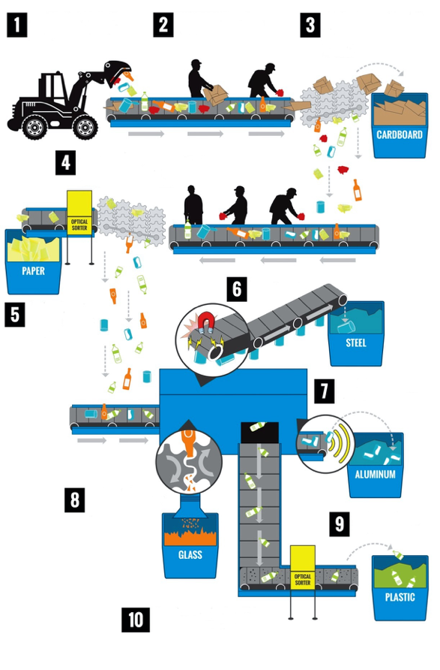
Unload Materials
Manual Sorting
Cardboard Separation
Optical Separation
Contaminants Removed
Magnetic Separation
Aluminum Separation
Glass Processing
Plastic Separation
Materials Baled
Source: Advanced Disposal, 2016

Slide 5
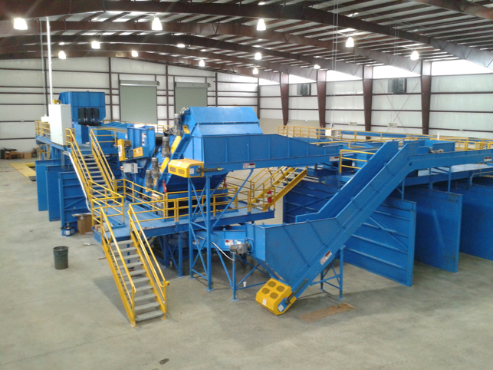
Source: Advanced Disposal, 2016

Slide 6
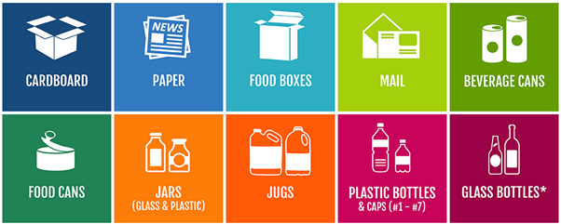
Common Recyclables
Source: Recycle Right, 2016

Slide 7
Genesee County Background

Slide 8
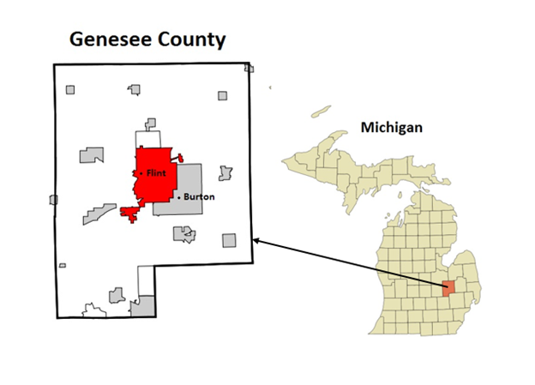
Southeastern Lower Peninsula
648 Square Miles
17 Townships
11 Cities
5 Villages
Source: Arkvan, 2007
Notes:
a total of 33 local unites

Slide 9
Socioeconomic Profile
Age Distribution
Median Household Incomes
Education Attainment

Slide 10
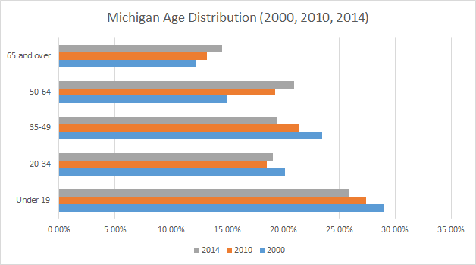
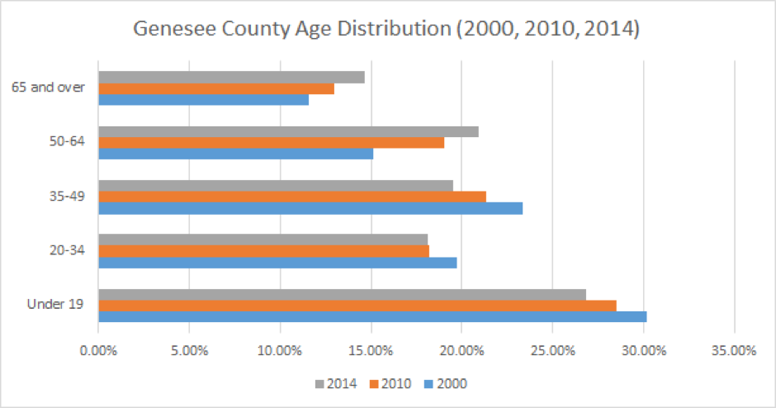
Age Distribution

Slide 11
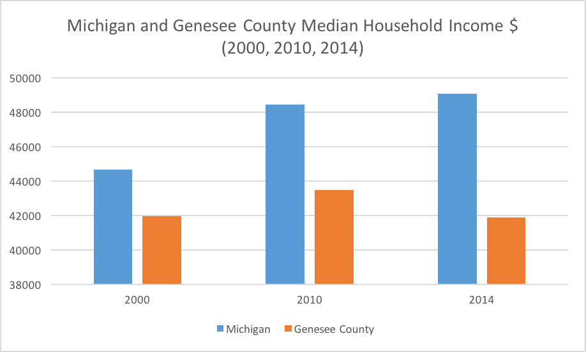
Median Household Income
Notes:
even thou the average median household income in michigan has steadly increased over time.
the Meidan household income in GC in 2014 is actaully lower than 14 years ago.
which make the gap between the state and the county more than 7,000 dollars

Slide 12
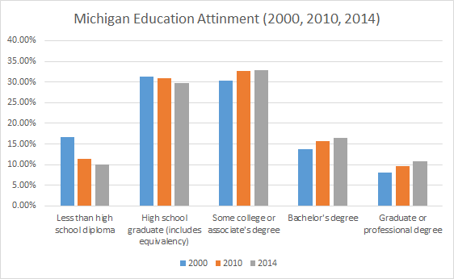
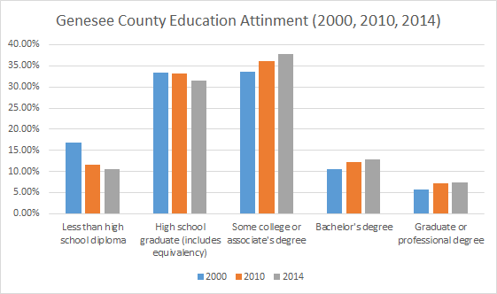
Education Attainment
Notes:
in gerenal the state population have reached a higher education level.
the population in both the areas have been reaching higher education level

Slide 13
Who Recycles
Literature Review
Higher Education
Older Age
Lower Income
We also researched the three highest and lowest municipal recycling rates found in Genesee County

Slide 14
Municipalities in Genesee County
High Recycling Rates
City of Swartz Creek 18.4%
City of Grand Blanc 14.4%
City of Fenton 10.9%
Low Recycling Rates
Argentine Township 1.6%
City of Mt. Morris 0.8%
Village of Otisville 0.6%

Slide 15
Genesee County Results
Lower Unemployment Rates
Renters
Younger Population
Higher Incomes
Higher Education
Higher Recycling Rates
Notes:
However, our findings has indicated the situation in Genesee is a bit different

Slide 16
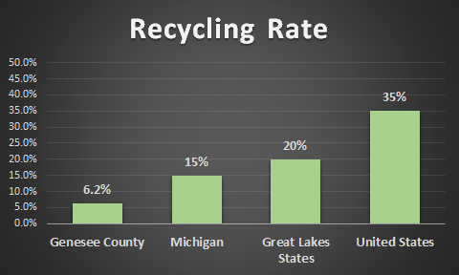
Recycling Rates

Slide 17
City of Flint’s Influence on Genesee County Recycling
Possibility of a greater recovery rate of recyclable materials
Implementing curbside pickup increased the participation rate from 5% to 16%
Creates 425 tons/year of additional recyclable materials
Recent increased use of plastic water bottles has potential of adding an additional 50 tons/year

Slide 18
Projected Genesee County Recycled Tonnage
City of Flint 2012
Recycled Material / # of Households = 0.073 tons/household/year
Genesee County 2013
Total number of participating households = 54,021
Goal set by Genesee County of 30% participation rate = 10,239 tons/year
Total Projected Tonnage = 9,658 tons/year

Slide 19
Case Studies
MRF’s
MRF Transferable Data
Education Programs
Business Models

Slide 20
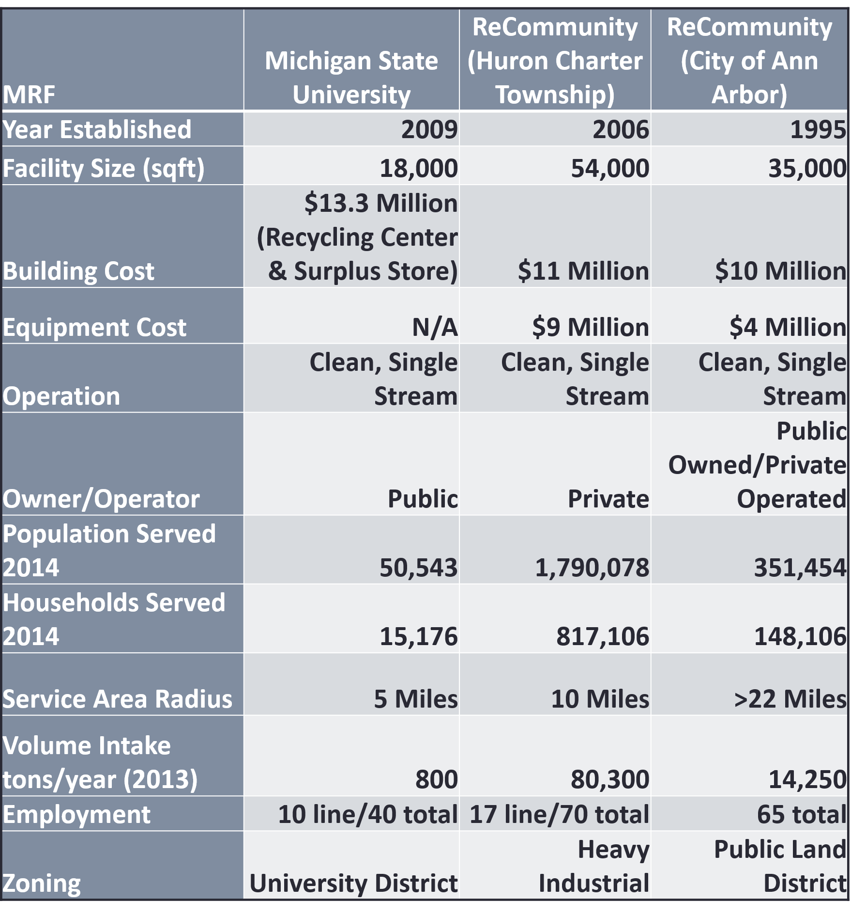
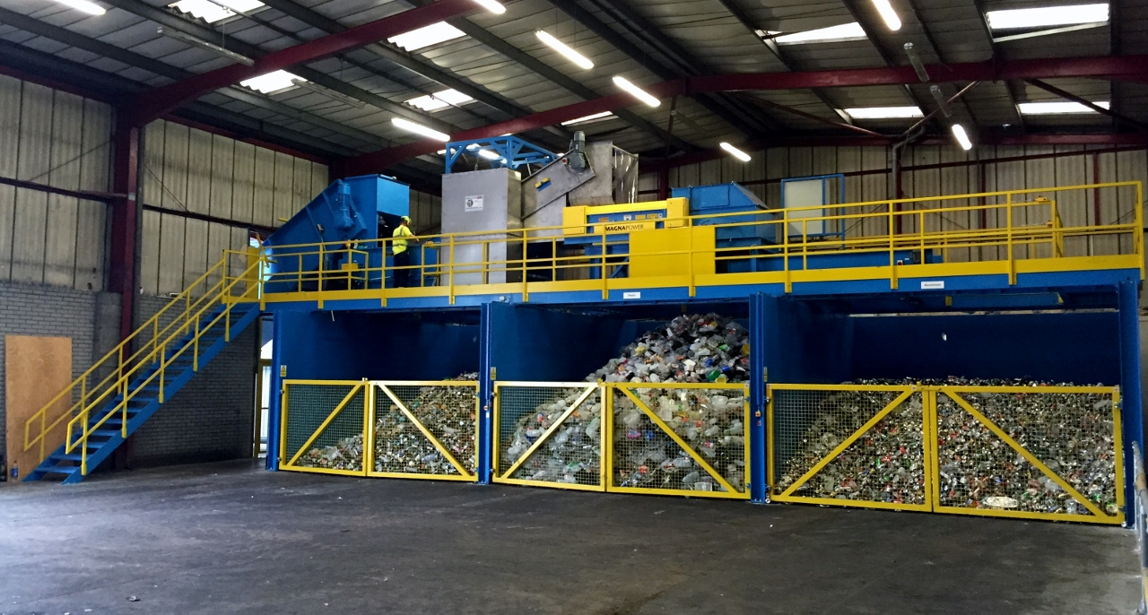
MRF’s
Source: Advanced Disposal, 2016

Slide 21
MRF Transferable Data
MRF Transferable Data
MRF | Michigan State University | ReCommunity (Huron) | City of Ann Arbor/ReCommunity
Area/Volume | 22.50 sq ft/ton | 0.67 sq ft/ton | 2.50 sq ft/ton
Volume/Household/Year | .05 tons/hh/yr | 0.10 tons/hh/yr | 0.01 tons/hh/yr
Area/Employment | 450 sq ft/person | 771.40 sq ft/person | 538.50 sq ft/person

Slide 22
Genesee County MRF Transferable Data
MRF | Genesee County
Area/Volume | 3.50 sq ft/ton
Volume/Household/Year | 0.17 ton/hh/yr
Area/Employment | 538.50 sq ft/person

Slide 23
Education Programs
Florida Green School Awards
Innovative K-12 programs with different recycling themes
City of East Lansing New Curbside Recycling Cart Program
Implementing single-stream curbside recycling to households
Boulder & Broomfield County Recycling Environmental Education Program
Education through various student activities such as group discussions and slideshow presentations
City of Knoxville Household Curbside Recycling Program
Motivating residents to recycle by providing free recycling carts

Slide 24
Business Models
Cost Model
Handles all financial costs that are incurred by the facility
Suitable for private recycling plants
Merchant Model
Relies on obtaining recyclable materials from waste haulers
Saves time and money
Reprocessing Model
Sorting the materials before they reach their end use manufacturers
The sorting is done by employees/machines at the MRF

Slide 25
Recommendations

Slide 26
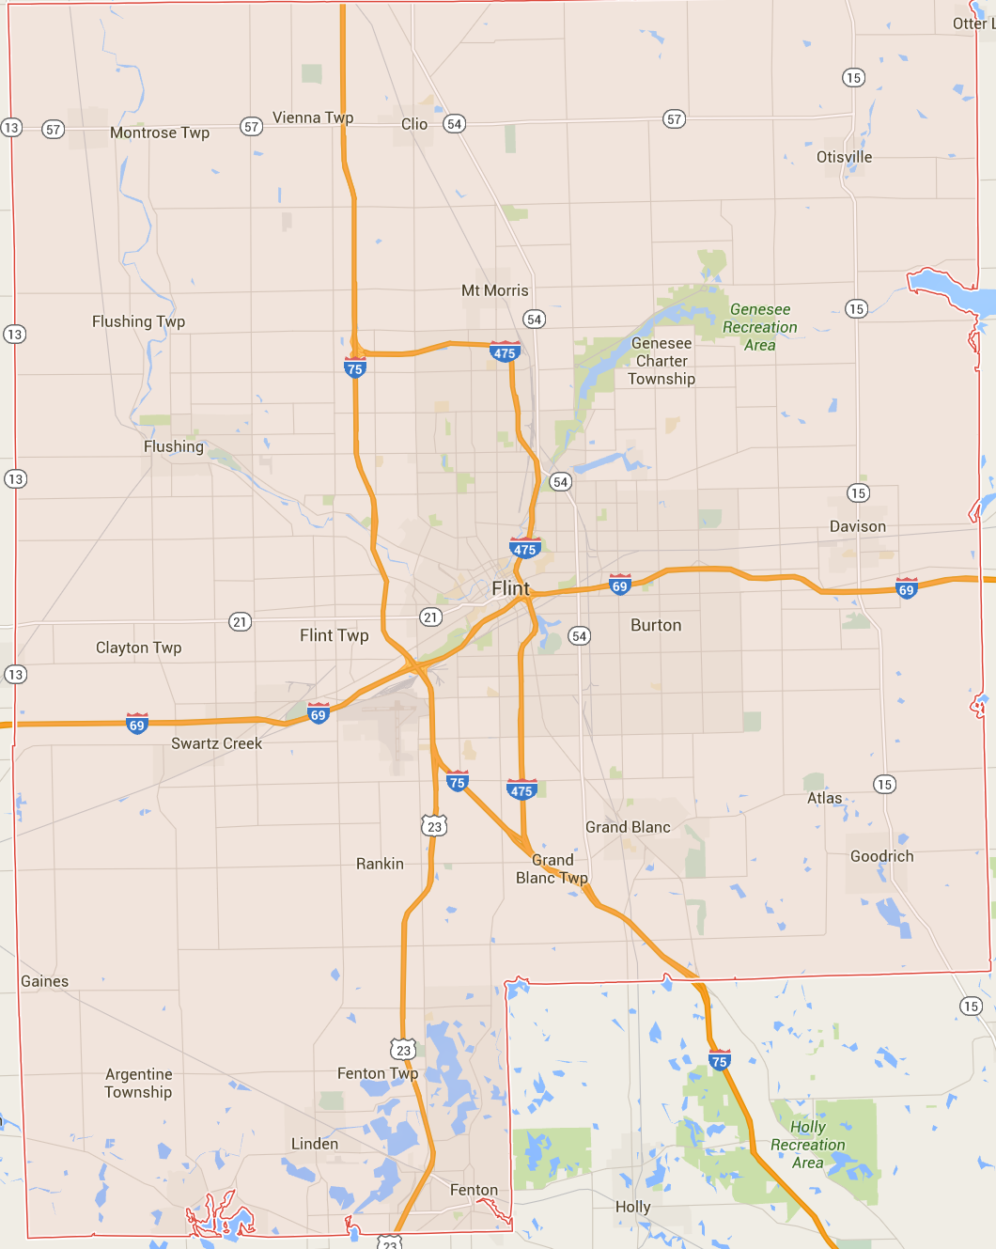
MRF Site Characteristics
Zoning
Heavy Industrial
Public Use Districts
Transportation Infrastructure
Accessibility to highways and road systems
Within 5-20 mile radius of residential service
Preferably closer to higher volume producing municipalities

Slide 27
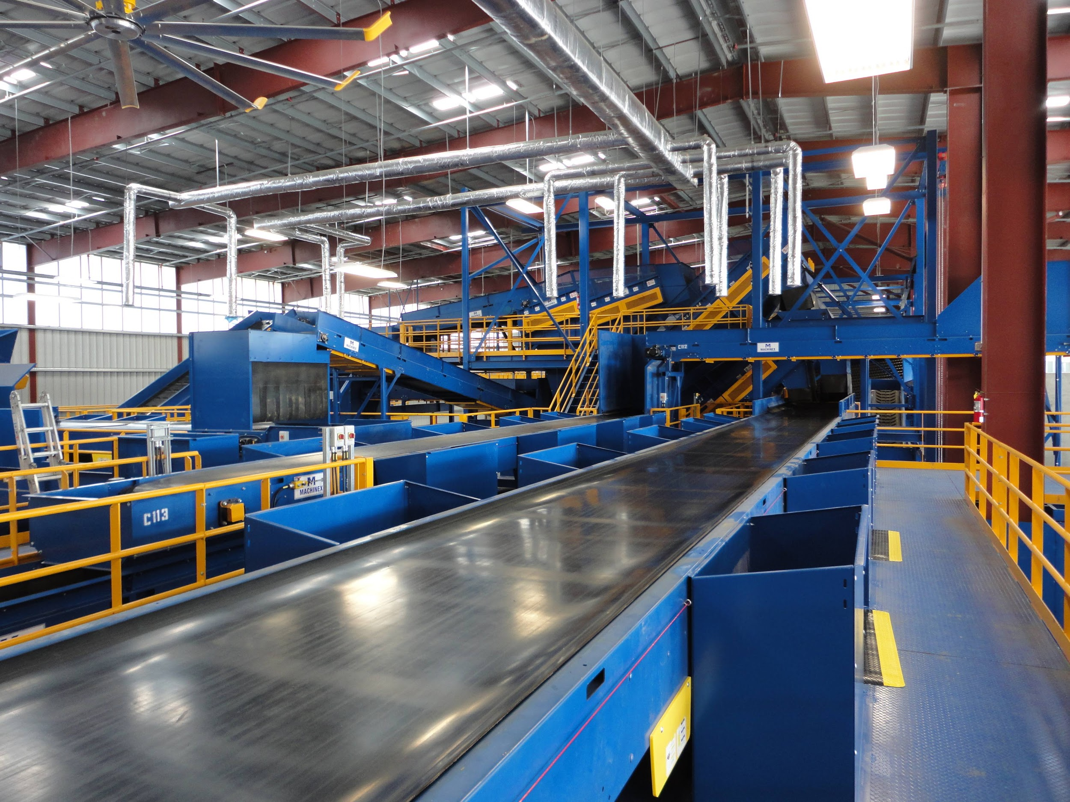
Facility
Operation
Clean, Single Stream
Size
35,000 square feet
Costs
Initial Startup Cost: $10 Million
Equipment Cost: $4 Million
Business Model
Merchant Model
Source: Advanced Disposal, 2016

Slide 28
Education Strategy
Employees
Stress the need of recycling by providing recycling incentives
Schools
Implement recycling programs and sustainability into the curriculum
Households
Social media and pamphlets to attract residents to encourage participation
Government and Nonprofit Organizations
Create grants to reward communities that develop innovative and creative ways to recycle
Notes:
Genesee County should make various innovation programs for different demographic categories

Slide 29
Cost Recovery
Recycled Materials | Annual Tons | Current Market Price ($/ton) | Annual Revenue
Plastic | 2,200 | 65 | $143,000
Waste Paper | 2,700 | 15 | $40,500
Glass | 600 | 8 | $4,800

Slide 30
Thank You
Go Green!

