Slide 1
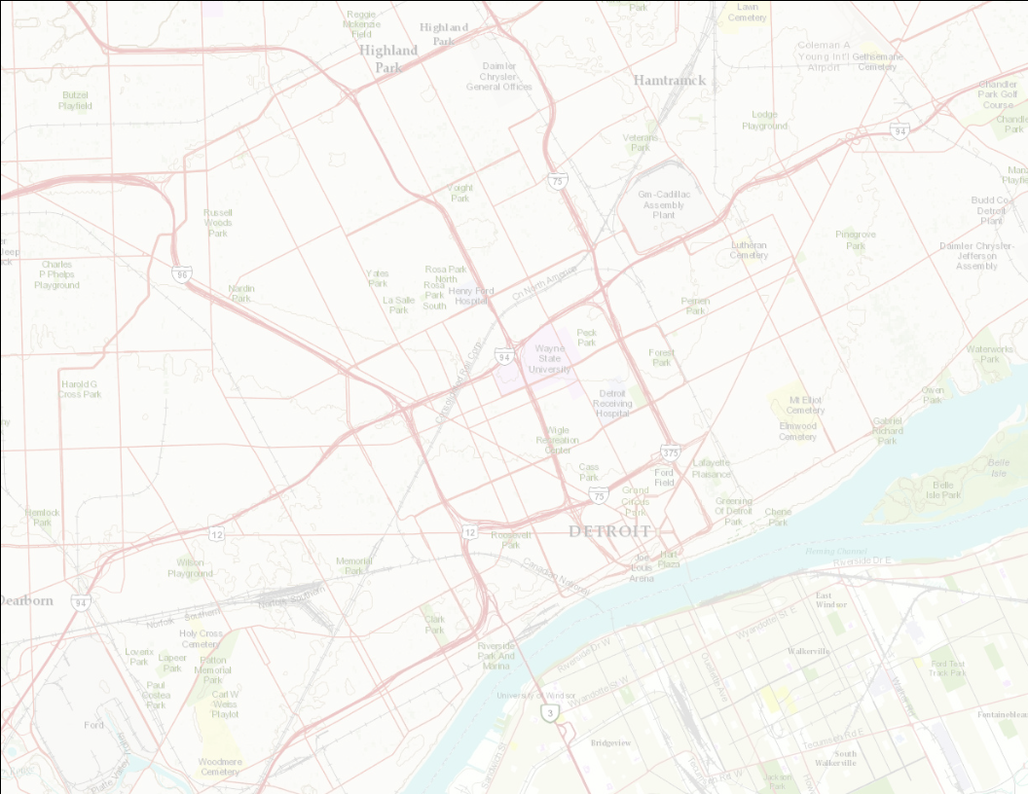
Development Trends and Developers in
Midtown Detroit
Rayman Mohamed
Wayne State University
Department of Urban Studies and Planning
joined by
Robin Boyle
Chair, Urban Studies and Planning

Slide 2
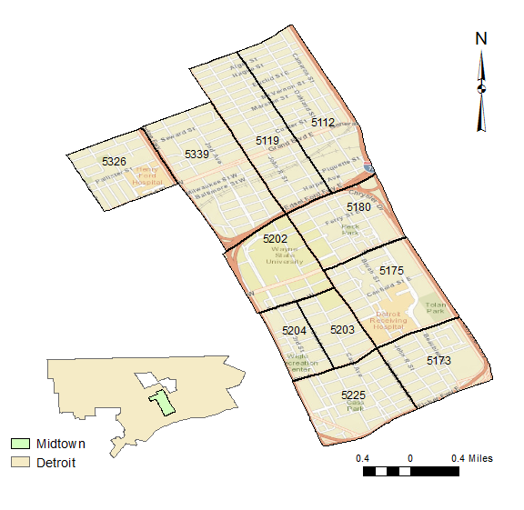

Slide 3
Recent Developments in Midtown, 2006 - 2011

Slide 4
Building permit activity in
Detroit and Midtown

Slide 5
Building permit activity in
Detroit and Midtown

Slide 6
Estimated costs of development activity in
Detroit and Midtown

Slide 7
Estimated value of development activity in
Detroit and Midtown

Slide 8
Incentives to Move to Midtown
$20,000 to $25,000 forgivable loan for home purchases
$2,000 for a signing a new lease
$1,000 for renewing a lease
Up to $5,000 match for exterior improvements

Slide 9
374 recipients
HFHS: 108
DMC: 114
WSU: 151

Slide 10
Location of Recipients in Midtown

Slide 11
Unique Locations of Recipients and Building Permits

Slide 12
Lessons?

