Slide 1
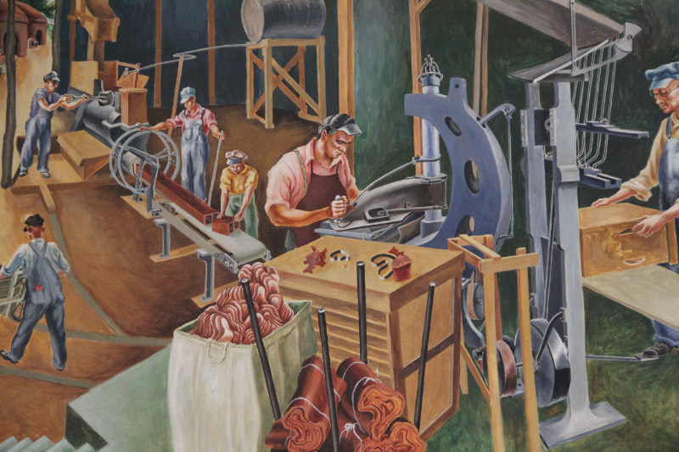
Skills gap or training gap? The role of manufacturing firms in solving the skills problem
The financial support for this research comes from the U.S. Department of Commerce, Economic Development Administration, and the Michigan State University Center for Regional Economic Innovation, and is gratefully acknowledged.
CAROLYN J.
HATCH
PhD

Slide 2

Overview of presentation
Why does manufacturing matter in MI?
Is manufacturing coming back to the US?
If so, what kind of manufacturing?
The skills problem
Manufacturing skills gap in MI
Solutions to the skills problem
    Role of clusters
    MI’s cluster strategy
Best practice solutions I-IV
CAROLYN J.
HATCH
PhD

Slide 3
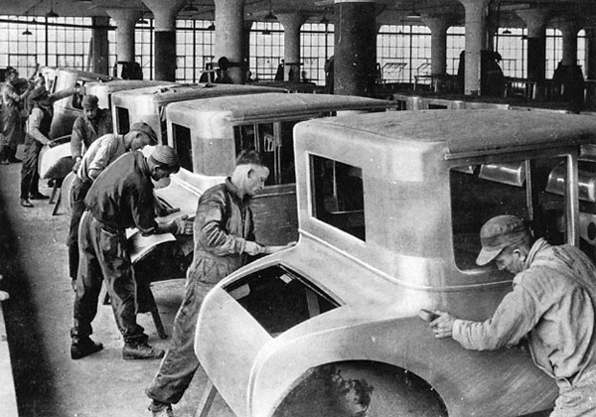
Why does manufacturing in Michigan matter?
auto industry’s mass production methods
core of the 20th C industrial revolution
sector employs 10% of the state’s workforce,
over ½ million people in production of autos
(and parts), metals, machinery,
breakfast cereal, furniture, plastics….
30% MI’s economic production, more
than twice that of any other sector
strong wage premium: average annual salary:$76,124 is $24,719 more than non-manufacturing workers
high levels of R&D: MI second in R&D spending, behind California, and first in industrial R&D intensity (NSF)
manufacturer SMEs are the backbone of MI communities
CAROLYN J.
HATCH
PhD

Slide 4
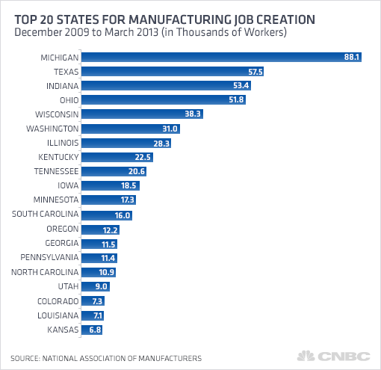
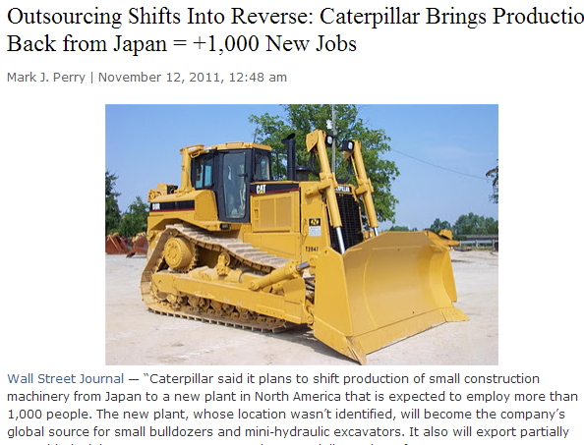
Is manufacturing coming back to the US?
weak dollar
transport costs
quality control
competitive wages
lower‐cost energy
CAROLYN J.
HATCH
PhD

Slide 5
If so, what kind of manufacturing?
Manufacturing today is part of a much more complex and tightly integrated global web
Much of manufacturing in the US centers on higher value-added activities that require highly skilled workers, unique knowledge from innovators or sophisticated infrastructure
(n=199)
Source: Deloitte, 2011
CAROLYN J.
HATCH
PhD

Slide 6
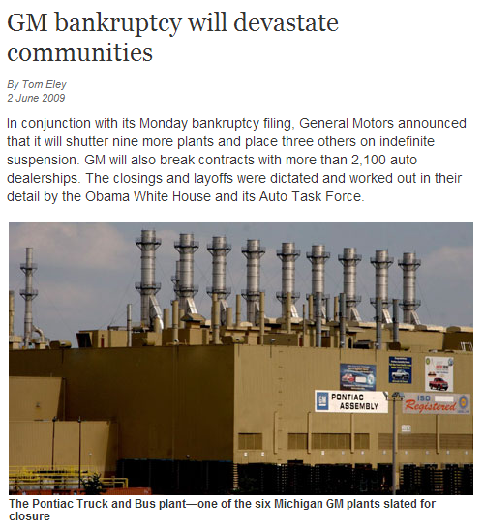
The skills problem
overt competition for qualified employees
outmigration of skilled workers
aging workforce
shortage of qualified applicants
pervasive stigma about manufacturing careers
“Moms and dads, grandmas and grandpas worked in those dirty stinkin’ factories and lost their jobs and then said ‘we don’t want that for our kids!’” Interviews
CAROLYN J.
HATCH
PhD

Slide 7
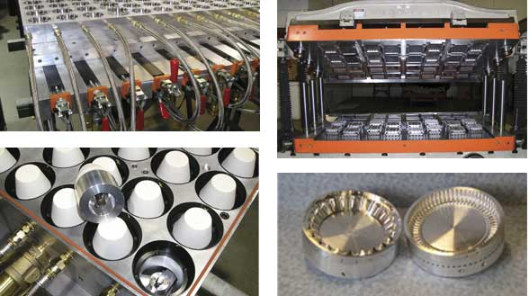
Skills gap and firm behavior
“If you want a good workforce, you have to pay for it.” Interviews
Skills, training and tenure conundrum in US economy
    Lack of investment in workforce (wages, benefits, training), lack of loyalty by firms
        Eg.: Findings from 2012 MI Tool & die survey: while 53.7% of co’s “prefer to hire those with certification”, average starting wage is $13.99 per hour
CAROLYN J.
HATCH
PhD

Slide 8

Skills gap and firm behavior
Higher wages / benefits isn’t even on the list!
Percentage of MI firms using following methods to reduce skills problem: (n=199)
CAROLYN J.
HATCH
PhD

Slide 9
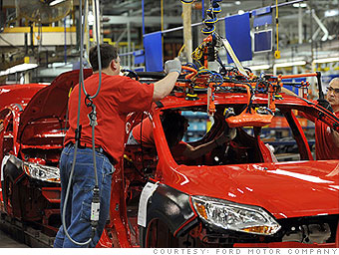
Manufacturing skills gap in Michigan
2011 survey by Deloitte: 69% of MI respondent firms (n=199) reported moderate to severe shortages of available qualified workers
47% reported serious shortage of skilled workers
75% reported increased shortage of skilled production workers over the next 3-5 years
CAROLYN J.
HATCH
PhD

Slide 10
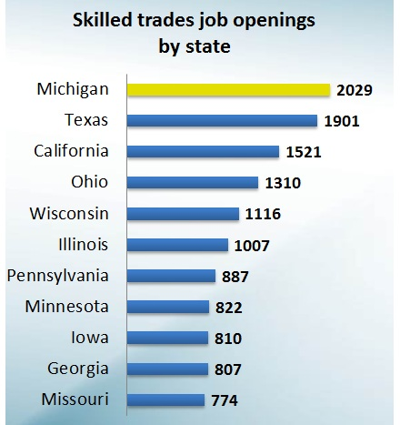
Manufacturing skills gap in Michigan
Job postings by state, Feb-May 2012
CAROLYN J.
HATCH
PhD
Source: WDA, via Burning Glass Technologies

Slide 11
Manufacturing skills gap in Michigan
Top 10 MSAs with CNC machinist demand Jan-Sept 2012
Source: WDA, via Burning Glass Technologies
CAROLYN J.
HATCH
PhD

Slide 12
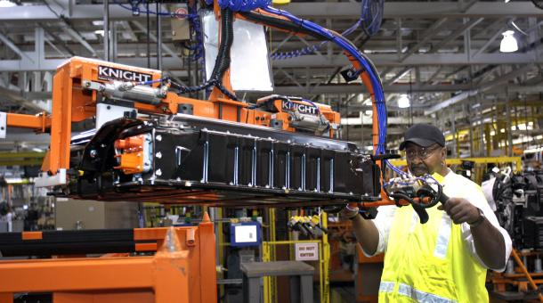
Solutions to the skills problem: the role of clusters
Public/private partnerships rapidly expanding across the US to address skills issue
  Collaborative networks of partners from all segments of community (private sector, government, education providers, industry associations, unions, economic developers) to address workforce development obstacles and meet long-term community needs
CAROLYN J.
HATCH
PhD

Slide 13

Michigan’s cluster strategy
MI Workforce Development Agency (WDA), in collaboration with the Economic Development Corporation (MEDC), has implemented cluster strategy to positively impact workforce development
Government plays a key role in convening employers and other regional stakeholders, and aligning efforts so partners can:
      collaborate to identify industry demand, provide input into design of educational programs to meet that demand
“Cluster” – geographic concentration of employers, industry suppliers and supporting institutions in similar or related industries
CAROLYN J.
HATCH
PhD

Slide 14

Best Practice I: Jackson Area Manufacturers Association
Innovative education pipeline provides manufacturing & engineering-related hands-on programming for kids age 0-5 & K12 (via summer camps, after school programs, K12 curriculum).
  I can make it! summer camp
  Engineering is elementary curriculum (K-5th grade)
  After school / summer design & build programs (9-12th grades)
Academy of Manufacturing Careers:
  Skilled trades training & apprenticeship program
CAROLYN J.
HATCH
PhD

Slide 15

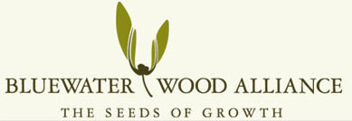
Best Practice II: Blue Water Wood Alliance
Cluster of wood products firms working together for purpose of joint projects in skills development (and other innovation-related goals)
BWA works with community colleges, high schools and other education providers to create high quality training programs at lower cost
CAROLYN J.
HATCH
PhD

Slide 16
Best Practice III: Mid-MI Community College
GOAL I
GOAL II
Create industry alliance with area manufacturers, economic developers, community agencies, educational institutions
Develop college curriculum:
1: Rapid Response (non- credit)
2: Certificate (credit)
3: Associate’s degree (credit)
MMCC: Creating Plastics Career Pathways in Rural Michigan
GOAL III
Recruit / retain students:
1: provide information and experiential opportunities:
    Schools of Promise
    Talent Search Grant
    Career awareness activities(touring plants, job shadowing, outreach / immersion activities)
2: Address remedial needs of rural, working students
CAROLYN J.
HATCH
PhD

Slide 17
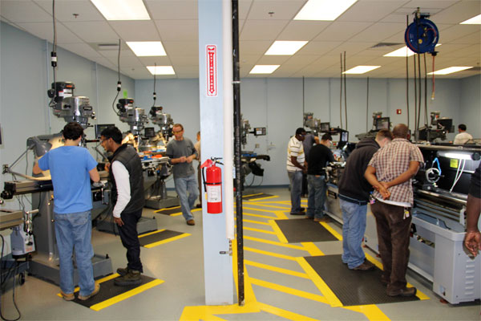
Best Practice IV: Firm-level strategies
MI thermoforming capital goods sector, Cnd. furniture industry
Critical need firms to invest in loyalty, engagement, and long-term development of their workforce through:
    competitive salaries / benefits
    skills and training provision
    culture of motivation (i.e. programs to recognize employees)
    performance-based pay / ownership (i.e. bonuses, profit-sharing, stock options)
    opportunities for career advancement / growth in the company
    cooperative management / labor relations
“The most successful companies are the ones that grow their own.” Interviews
CAROLYN J.
HATCH
PhD

Slide 18
Thank you for listening!!
Questions, comments, ideas? Please share during the following discussion, or contact me at:
carolyn.hatch@mail.utoronto.ca
The financial support for this research comes from the U.S. Department of Commerce, Economic Development Administration and the Michigan State University Center for Regional Economic Innovation, and is gratefully acknowledged.

